Slide 1

PROJECT FINAL REPORT
[1]
Team Sprinters
Members: Bhupinder Jagwani, Moranda Gao, Niveditha Shanbhag, Pallavi Saboo, Pratik Deshmukh, Zhaoyi Zhang and Madhavi Ranganadha
[1]: (n.d.). Retrieved from freepix.com: https://www.freepik.com/vectors/business-character
Notes:
Title Slide
Total slides = 60 mins (14 Title + 44 Simple + 3 Average + 5 Backup = 66 Total Slides)
Calculation Rationale - Title = 0.5 mins, Simple = 1 min, Average = 3 mins, Backup = 0 mins

Slide 2







OUR TEAM
Photo
Photo
Pallavi Saboo
Role: Scrum Master
Bhupinder Jagwani
Role: Product Owner
Pratik Deshmukh
Role: Support
Photo
Photo
Moranda Gao
Role: Software Developer
Zhaoyi Zhang
Role: Software Developer
Niveditha Shanbhag
Role: Software Tester
Madhavi Ranganadha
Role: Data Analyst
Notes:
Title Slide

Slide 3
TABLE OF CONTENTS
01
02
03
04
05
MARKET RESEARCH
OSS RESEARCH
SDLC MODEL
COMPANY
OVERVIEW
BUSINESS REQUIREMENTS
06
07
08
09
10
SYSTEM
ARCHITECTURE
ROADMAP
SPRINT PLANNING & BURNUP CHART
ROI & ROV
RISK MANAGEMENT
Notes:
Simple Slide

Slide 4

COMPANY OVERVIEW
[3]
About Us:
Our Vision:
Our Mission:
Year founded: 2019
Headquarters: San Francisco, CA
Employees: 100
Revenue Stream:We provide ad services for publishers and earn revenue of 20% from the ad revenue, rest goes back to the publisher.[2]
Sprinters Inc provides products and services to online publishers to help them grow, operate their business, understand their readership and manage consumer data. We help publishers and content creators efficiently manage ad space on their site.[1]
Our aim is to help our customers make and keep more of their hard-earned revenues, by providing them tools, services and insights to make better decisions and investments.[1]
SPRINTERS ADTECH
[1] sovrn. (n.d.). More ways to grow your revenue. Retrieved from sovrn.com: https://www.sovrn.com/
[2] sovrn. (2022, March 8). All About Ad Servers. Retrieved from sovrn.com: https://www.sovrn.com/blog/all-about-ad-servers/
[3]freepik. (n.d.). Gradient s logo templates Free Vector. Retrieved from freepik.com: https://www.freepik.com/free-vector/gradient-s-logo-templates_13220136.htm#query=s&position=2&from_view=keyword
Notes:
Simple Slide

Slide 5
CURRENT PROBLEMS
Problem Statement:
We currently work with 2000 publishers across 10,000 websites and are observing 1 Million + ad impressions on a daily basis. As we grow at the current speed, we want to analyse our current customers by doing customer segmentation. This will help our marketing team to strategically target their marketing efforts towards our key customer segments, increase leads and eventually increase revenue. We are currently working with Hadoop(Hive) and using MapReduce for data processing. Query performance on Hadoop is time consuming and requires a lot of query modification.[1]
We have observed that in order to process 332 queries on 100TB of database, Hive needed 40 hours. It is crucial to improve performance of query while processing terabytes of data. Using the existing technology, it is also difficult to apply ML algorithms to achieve customer segmentation analysis.
We need Apache Spark to do this. [2]
[1] ProjectPro. (2022, April 6). Hadoop vs. Spark: Not Mutually Exclusive but Better Together. Retrieved from projectpro.io: https://www.projectpro.io/article/hadoop-vs-spark-not-mutually-exclusive-but-better-together/235
[2] glensheffield. (2013, November 3). IBM Big SQL Benchmark vs. Cloudera Impala and Hortonworks Hive/Tez. Retrieved from shefsite.wordpress.com: https://shefsite.wordpress.com/2014/11/03/ibm-big-sql-benchmark-vs-cloudera-impala-and-hortonworks-hivetez/
Notes:
Simple Slide

Slide 6
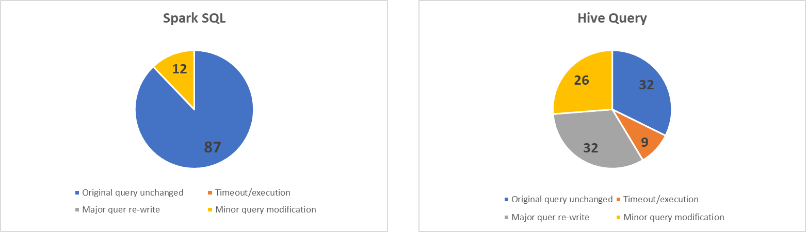
Spark vs Hadoop Query Performance
99 queries were tested on 50GB database
[1]
12 queries required minor modification
Took 1 hour to complete
9 queries had execution error and timed out after 5 hours
Took 5 hours to complete
26 queries needed modification(mainly type casts)
[1] glensheffield. (2013, November 3). IBM Big SQL Benchmark vs. Cloudera Impala and Hortonworks Hive/Tez. Retrieved from shefsite.wordpress.com: https://shefsite.wordpress.com/2014/11/03/ibm-big-sql-benchmark-vs-cloudera-impala-and-hortonworks-hivetez/
Notes:
Simple Slide

Slide 7

Customer Segmentation
The importance of Customer Segmentation
Create and communicate targeted marketing messages that will resonate with specific groups of customers
Identify ways to improve products or new product or service opportunities.
Focus on the most profitable customers.
Improve customer service.[2]
Top level outlook of the problem and benefits of the solution
Currently, our marketing team is blindly targeting all segments of publishers
Understanding our current data about customers and segmenting them and further dissecting and analysis will help them target their efforts towards these top paying customer segments. For example, fashion, sports-bloggers, etc. to get better leads and eventually more customers
Knowing which segments are profitable will help in strategically targeting those segments further and also on the segments we are lacking to target and diversify our portfolio
The product team can enhance our advertising features and hone them for top revenue generating customer segments for us to enhance value of our product further
[1]
[1](n.d.). Retrieved from freepix.com: https://www.freepik.com/search?format=search&query=customer%20segmentation&selection=1&type=vector
[2] shopify. (n.d.). Customer Segmentation. Retrieved from shopify.com: https://www.shopify.com/encyclopedia/customer-segmentation
Notes:
Simple Slide

Slide 8
OSS PROJECT & HYPOTHESIS
Project Objective:
Integrate Apache Spark in Hadoop environment by March 2023 so that customer segmentation results are available by end of Q2 2023, in order for marketing team to be able to achieve annual revenue/sales target
Success Criteria:
20% more growth in revenue / customer acquisition with the renewed Marketing Strategy
Reduce query processing time by 60%, leading to increased productivity of system and developer
Hypothesis:
By integrating Apache spark in Hadoop environment our organization would be able to do customer segmentation analysis that would allow marketers to better tailor their marketing efforts to various audience subsets. Those efforts can relate to both communications and product development resulting in improved customer service.
[1] shopify. (n.d.). Customer Segmentation. Retrieved from shopify.com: https://www.shopify.com/encyclopedia/customer-segmentation
Notes:
Simple Slide

Slide 9

Market Research for Potential Solution
Notes:
Title Slide

Slide 10
COMPETITIVE ANALYSIS
 | HADOOP | SPARK
DATA SIZE | 102.5 TB | 100 TB
ELAPSED TIME | 72 mins | 23 mins
#NODES | 2100 | 206
#CORES | 50400 Physical | 6592 virtualized
CLUSTER DISK THROUGHPUT | 3150 GB/s (est.) | 618 GB/s
SORT BENCHMARK DAYTONA RULES | Yes | Yes
NETWORK | Dedicated data center, 10 Gbps | Virtualized (EC2), 10 Gbps
SORT RATE | 1.42 TB/min | 4.27 TB/min
SORT RATE/NODE | 0.67 GB/min | 20.7 GB/min
[1]
[1] llyukha, V. (n.d.). Hadoop vs. Spark: How to Choose Between the Two? Retrieved from jelvix.com: https://jelvix.com/blog/hadoop-vs-spark-what-to-choose-to-process-big-data
Notes:
Simple Slide
Combine 11 and 12

Slide 11
COMPETITIVE ANALYSIS
 | HADOOP | FLINK | SPARK
REAL TIME | None | Real time | Near Real time
PERFORMANCE | Slower | Processes data at lightning speed | Fast (Slower compared to Flink)
LATENCY | High | Low | Low (High compared to Flink)
MACHINE LEARNING | Requires Apache Mahout. However, there are performance limitations | FlinkML supports machine learning library | Supports analytical frameworks and machine learning library
ITERATIVE PROCESSING | Does not support | Supports Iterative Processing | Supports Iterative Processing
EASE OF USE | Complex framework, no interactive mode | Does not have cloud offerings, so setting up and running flink is time consuming | Has cloud offerings to start development with few clicks
USE CASES | Inventory Forecasting Fraud detection Supply chain efficiency Historical data analysis | Fraud detection Anomaly detection Rule-based alerting Business process monitoring Web application (social network) | Customer Segmentation Marketing research Recommendation engines Achieving quick results
[1][2]
[1]:Macrometa. (2021, September 10). Apache Spark Vs Flink. Retrieved from macrometa.com: https://www.macrometa.com/event-stream-processing/spark-vs-flink
[2]: Lawton, G. (2022, February 17). Hadoop vs. Spark: An in-depth big data framework comparison. Retrieved from techtarget.com: https://www.techtarget.com/searchdatamanagement/feature/Hadoop-vs-Spark-Comparing-the-two-big-data-frameworks
Notes:
Simple Slide

Slide 12
SWOT ANALYSIS
 | HADOOP[1] | SPARK[2]
Strengths | Scalable Data Agnostic Fault tolerant Cost Effective | Run workloads faster Write applications quickly in Java, Scala, Python & SQL Access diverse data sources Used in wide range of organizations
Weakness | Usability Configuration sensitive Slow Highly complex | No File Management No support for real time processing Problem with small file Memory Management
Opportunities | Versatile Ecosystem Low barrier to entry Data products | Real time data processing Seamlessly integrating complex capabilities Simplify challenging and compute-intensive task of processing high volumes of data.
Threats | Incumbent Technology Data security issues Low performance | Various technologies overtaking spark Memory processing can be expensive
[1]: Zicari, R. (2015, May 28). The Data Lake: A Brief SWOT Analysis. Retrieved from odbms.org: http://www.odbms.org/2015/05/the-data-lake-a-brief-swot-analysis/
[2]:Renova Cloud. (n.d.). AN INTRODUCTION TO AND EVALUATION OF APACHE SPARK FOR BIG DATA ARCHITECTURES. Retrieved from renovacloud.com: https://renovacloud.com/an-introduction-to-and-evaluation-of-apache-spark-for-big-data-architectures/?lang=en
Notes:
Simple Slide

Slide 13
OSS Research
Apache Spark
Notes:
Title Slide

Slide 14



UPSTREAM
^{[4]}
^{[1]}
^{[3]}
MLlib
^{[2]}
Streaming
SQL
GraphX
[1]: Scala. (n.d.). Retrieved from upload.wikimedia.org: https://upload.wikimedia.org/wikipedia/commons/thumb/3/39/Scala-full-color.svg/1200px-Scala-full-color.svg.png
[2]: JVM (Java Virtual Machine). (n.d.). Retrieved from i.ytimg.com: https://i.ytimg.com/vi/G1ubVOl9IBw/maxresdefault.jpg
[3]: Apache Software Foundation. (2013). Wikimedia Commons. Retrieved from commons.wikimedia.org: https://commons.wikimedia.org/wiki/File:Apache_Spark_logo.svg
[4]: databricks. (n.d.). Apache Spark. Retrieved from databricks.com: https://databricks.com/spark/about
Notes:
Simple Slide

Slide 15


DOWNSTREAM
^{[2]}
^{[1]}
^{[3]}
[1]: Jupyter. (n.d.). Retrieved from upload.wikimedia.org: https://upload.wikimedia.org/wikipedia/commons/3/38/Jupyter_logo.svg
[2]: Apache Software Foundation. (2013). Wikimedia Commons. Retrieved from commons.wikimedia.org: https://commons.wikimedia.org/wiki/File:Apache_Spark_logo.svg
[3]: Anaconda. (n.d.). Retrieved from upload.wikimedia.org: https://upload.wikimedia.org/wikipedia/en/c/cd/Anaconda_Logo.png
Notes:
Simple Slide

Slide 16
APACHE SPARK PRINCIPLES & PRINCIPALS
Design Principles:
In need of an powerful engine that can process data in real-time as well as batch mode ^{[1]}
A new framework optimized for fast iterative processing like machine learning, and interactive data analysis ^{[2]}
Principals:
Committers: Dilip Biswal (Adobe), Jason Dai (Intel), Ankur Dave (UC Berkeley), etc.^{[3]}
Maintainers: Apache Software Foundation ^{[4]}
Sponsors:
Sameer Agarwal (Facebook), Michael Armbrust (Databricks)^{[3]}
Contributors:
Shane Huang (Intel), Yinan Li (Google) ^{[3]}
End Users ^{[6]}:
Yelp: Yelp’s advertising targeting team makes prediction models to determine the likelihood of a user interacting with an advertisement.
Zillow: Zillow uses machine-learning algorithms from Spark to process large data sets in near real time to calculate Zestimates.
[1] TechVidvan. (n.d.). Apache Spark Design Principles- Why Spark Matters. Retrieved from techvidvan.com: https://techvidvan.com/tutorials/spark-design-principles/#:~:text=Hence%2C%20the%20major%20one%20of,need%20of%20a%20unified%20engine.&text=Apache%20Spark%20leverages%20the%20advantage,learning%20and%20graph%20processing%20easily
[2].aws. (n.d.). Introduction to Apache Spark. Retrieved from aws.amazon.com: https://aws.amazon.com/big-data/what-is-spark/#:~:text=The%20goal%20of%20Spark%20was,fault%20tolerance%20of%20Hadoop%20MapReduce
[3] Apache Spark. (2018). Current Committers. Retrieved from spark.apache.org: https://spark.apache.org/committers.html
[4] The Apache Software Foundation. (2022). COMMUNITY-LED DEVELOPMENT "THE APACHE WAY". Retrieved from APACHECON: https://www.apache.org/
[5] Introduction to Apache Spark. (2022). Retrieved from aws.amazon.com: https://aws.amazon.com/big-data/what-is-spark/
Notes:
Simple Slide

Slide 17
Business Requirements
Notes:
Title Slide

Slide 18
BUSINESS OBJECTIVES & PROJECT REQUIREMENTS
Business Objectives:
Identify and deliver more targeted marketing campaigns.
Increase productivity of data analysts/data engineers.
Customer segmentation will help provide business insights to get more leads which will translate into sales.
Project Requirements:
Data Access:
Data architects should be able to provide libraries of limited data access to data analysts.
Data analysts should have access to the data they need for performing customer segmentation.
Customer Segmentation:
Data analysts should understand machine learning algorithms and Spark.
Spark Performance:
Spark should be launchable and compatible with Hadoop 2.0(YARN) 24/7 and all 365 days.
Spark should process data faster than Hadoop.
Cultural/Political Requirements:
The business should abide by all government rules and regulations.
Customer segmentation results will be kept confidential within the company and will not be traded.
Notes:
Simple Slide

Slide 19





PERSONAS
[1]
[1]
[1]
[1]
[1]
Data Architect
Data Analyst
Product Manager
Marketing Manager
Software Tester
[1]: (n.d.). Retrieved from freepix.com: https://www.freepik.com/vectors/business-character
Notes:
Title Slide

Slide 20
STORY POINTS ALGORITHM & RATIONALE
 | GRADING | POINTS | RATIONAL
Fibonacci | SIMPLE | 1 | The task is small, specific, and cannot be broken down into subtasks. The team fully understand the task and requirements so that takes minimum effort to fulfill. The task requires less than 1 day to complete and has no dependencies.
 |  | 2 | The task is small, specific, and cannot be broken down into subtasks. The team fully understand the task and requirements so that takes minimum effort to fulfill. The task requires less than 2 days to complete and has no dependencies.
 | AVERAGE | 3 | The task is small and can be broken down into 1-2 subtasks. The team understand the majority of the task and requirements but still needs clarification on small portions. The task requires less than 5 days to complete and has at most 1 predecessor.
 |  | 5 | The task is medium and can be broken down into 1-3 subtasks. The team understand the general scope of the task and requirements but still needs clarification on some portions. The task requires less than 2 weeks to complete and has at most 2 predecessors.
 | COMPLEX | 8 | The task is large and can be broken down into more than 3 subtasks. The team understand the general scope of the task and requirements but needs clarification on majority of the portions. The task requires less than 3 weeks to complete and has more than 2 predecessors.
Notes:
Simple Slide

Slide 21
DATA ARCHITECT - JANE TRAN
BACKGROUND
34 Years old, lives in California
Master’s in IS from SCU; With Sprinters Inc. for 2 years
Assessed Sprinters’ potential data sources and designed a structure to store, integrate, and maintain data.
Works cross-functionally with marketing team, product team, and analytics team to build out a platform for Sprinters Inc. to analyze insights.
[1]
FUNCTIONS
Plan and design big-data systems and handle large-scale development of Hadoop applications
Define data standards and principles
Translate business requirements into technology needs
CHARACTERISTICS
Always be punctual
Attention to detail & precise
KEY NEEDS / PAIN POINTS
The current system doesn’t have dynamic scalability, and has sub-optimal data transformation. ^{[2]}
[1] (n.d.). Retrieved from freepix.com: https://www.freepik.com/vectors/business-character
[2] AI TechPark. (2021, Jan 11). Top 5 Pain Points for Big Data Infrastructure and how to solve them. Retrieved from ai-techpark.com: https://ai-techpark.com/top-5-pain-points-for-big-data-infrastructure-and-how-to-solve-them/
Notes:
Simple Slide

Slide 22
USER STORY - DATA ARCHITECT
 | STORY TYPE | PRIORITY LEVEL | STORY POINTS | THEME | USER STORY CONTENT | ACCEPTANCE CRITERIA
0. | EPIC USER STORY | 1 | 19 | Data Access | As Jane Tran (data architect), I want to maintain HDFS and provide modules/libraries of limited data access to data analysts so that data analysts can successfully access to the data. | Data analysts can only access to the data they need to perform customer segmentation tasks. HDFS is not affected by Spark implementation.
1.1 | LEVEL 1 | 1 | 8 | Spark Integration | As Jane Tran (data architect), I want to set Hadoop environment variables and configure memory allocation so that Spark can be aware of Hadoop configuration and be integrated into our current system architecture. | Spark interacts with YARN cluster without raising any error. Allocation of Spark containers to run in YARN containers does not fail.
1.2 | LEVEL 1 | 1 | 5 | Data Access | As Jane Tran (data architect), I want to provide limited data access to data analysts so that they do not modify data stored in HDFS. | Data analysts can only access to the data they need to perform customer segmentation otherwise raising error message.
1.3 | LEVEL 1 | 1 | 8 | Data Connection | As Jane Tran (data architect), I want to provide a module/library to data analysts so that they do not need to connect to HDFS using Spark on their own. | Data analysts can read in the data they need by including the module data architects provide them.
AI TechPark. (2021, Jan 11). Top 5 Pain Points for Big Data Infrastructure and how to solve them. Retrieved from ai-techpark.com: https://ai-techpark.com/top-5-pain-points-for-big-data-infrastructure-and-how-to-solve-them//
Notes:
Simple Slide

Slide 23
DATA ANALYST - ZUNI JACOB
BACKGROUND
30 year old Data Analyst, originally from Singapore, now settled in San Francisco
Recent graduate from SCU in MSIS and with Sprinters for the last 6 months
Loves social media, baking and photography in her free time
[1]
FUNCTIONS
Understands and extracts data based on requirements by several teams
Does Data Analysis using various data cleaning tools and Machine Learning techniques if required
Creates dashboards / visuals in PowerBI if needed
CHARACTERISTICS
Enthusiastic and creative
Loves to deliver work ahead of time
Highly organised
KEY NEEDS / PAIN POINTS
Running the queries in the current system is very slow and requires modifications several times.
Cannot perform machine learning effectively with current system and its difficult to code for as well.
[1] (n.d.). Retrieved from freepix.com: https://www.freepik.com/vectors/business-character
Notes:
Simple Slide

Slide 24
USER STORY - DATA ANALYST
 | STORY TYPE | PRIORITY LEVEL | STORY POINTS | THEME | USER STORY CONTENT | ACCEPTANCE CRITERIA
0. | EPIC USER STORY | 1 | 14 | Customer Data Analysis | As Zuni Jacob(data analyst), I want to provide analysis regarding our existing customers so that I can meet the requirements of the asking teams | The results of the analysis should check off all the requirements from the asking team.
1.1 | LEVEL 1 | 1 | 1 | Data Access | As Zuni Jacob(data analyst), I want to be able to access the customer data using the modules / libraries provided by the Data Architect so that I can perform data cleaning & analysis on the data. | The access is available and error free.
1.2 | LEVEL 1 | 1 | 8 | Customer Segmentation | As Zuni Jacob(data analyst), I want to use Spark’s Machine Learning libraries to get customer segmentation results so that I can get results faster than Hadoop. | The analysis should take half the time or less than on Hadoop.
1.3 | LEVEL 1 | 2 | 5 | Provide Visuals | As Zuni Jacob(data analyst), I want to use my analysis; results and provide dashboards regarding our customer data so that the asking team can make informed business decisions. | The analysis will determine the key customer segments in the visuals.
Notes:
Simple Slide
Story Points:
Algorithm - Fibonacci numbers
Simple tasks - 1, 2
Average tasks - 3, 5
Complex tasks - 8

Slide 25
PRODUCT MANAGER - ALEX WILLIAMS
BACKGROUND
40 years old and father of two
Technology enthusiast and customer-centric & growth-oriented Product manager with 10 years of experience
With Sprinters Inc. for 1 year
Loves mountain biking, reading and traveling
[1]
FUNCTIONS
Looks for quality products that enhance teams productivity
Understand his users and their requirements
Use better system that allows quicker reporting
CHARACTERISTICS
Technology Enthusiast
Customer Focused
KEY NEEDS / PAIN POINTS
The current system cannot provide a detailed customer segmentation information, so cannot develop customer centric product features.
[1](n.d.). Retrieved from freepix.com: https://www.freepik.com/vectors/business-character
Notes:
Simple Slide

Slide 26
USER STORY - PRODUCT MANAGER
 | STORY TYPE | PRIORITY LEVEL | STORY POINTS | THEME | USER STORY CONTENT | ACCEPTANCE CRITERIA
0. | EPIC USER STORY | 1 | 8 | Build customer centric products | As Alex Williams(Product Manager) I want to develop products that would resonate with specific target audience so that I can build products that are viable for the business. | Product sales for the new target segment should increase sales by at least 20%
1.1 | LEVEL 1 | 1 | 5 | Customer Segmentation | As Alex Williams(Product Manager) I want to address pain points of customer segments so that I can prioritize key features for product development and build product roadmap | Newly added feature set to the product should increase revenues of the product line by at least 15%
1.2 | Level 2 | 1 | 3 | Utilize Visuals | As Alex Williams(Product Manager) I want to use dashboards to visualize reports so that I can track our customer segments | Product manager should be able to visualize daily/weekly/monthly active customer metrics using dashboard
Notes:
Simple Slide
Story Points:
Algorithm - Fibonacci numbers
Simple tasks - 1, 2
Average tasks - 3, 5
Complex tasks - 8

Slide 27
MARKETING MANAGER - GARY WYNYARD
BACKGROUND
50 years old marketing manager, joined Sprinters inc 5 years ago.
Gary was born in Babruysk in the Soviet Union and immigrated to the United States at the age of three.
Graduated with a bachelor’s degree in management science.
With his life experience of working in many different fields and industries, Gary helps the Sprinters with analyzing and predicting the market demand to meet the satisfaction of customer.
[1]
FUNCTIONS
Developing, implementing and executing strategic marketing plans
Championing customer relationship management in the organization
Predicting and planning for the future market demand
Analyzes customer data received from analytics team to make business decisions
CHARACTERISTICS
With good critical thinking and organization skills
Sophisticated and experienced
KEY NEEDS / PAIN POINTS
The current system cannot provide a detailed customer segmentation information / dashboards / visuals, so cannot develop customer centric marketing campaigns / strategies.
[1](n.d.). Retrieved from freepix.com: https://www.freepik.com/vectors/business-character
Notes:
Simple Slide

Slide 28
USER STORY - MARKETING MANAGER
 | STORY TYPE | PRIORITY LEVEL | STORY POINTS | THEME | USER STORY CONTENT | ACCEPTANCE CRITERIA
0. | EPIC USER STORY | 1 | 6 | Marketing Strategy | As Gary Wynyard (marketing manager), I want to understand and analyze the market, so that I can develop, implement and execute strategic market plans. | Marketing manager should be able to visualize sales metrics related to key customer segments to develop expansion and new customer acquisition strategies
1.1 | LEVEL 1 | 1 | 3 | Marketing Research | As Gary Wynyard (marketing manager), I want to identify key customer segments, so that I can adjust the marketing strategy according to the new customer segmentation. | The new research should generate at least 30% more leads than before.
1.2 | Level 2 | 1 | 3 | Customer Acquisition | As Gary Wynyard (marketing manager), I want to use the market research and target the identified key customer segments so that I can generate more sales. | The new market research should generate 20% more revenue / customer acquisition.
Notes:
Simple Slide

Slide 29
SOFTWARE TESTER - JACK ARANDA
BACKGROUND
45 Years old, born in New York and lives in California
Bachelor`s of Information Technology from UW-Madison
Currently employed as a software tester in Sprinters Inc.
Held many prior roles in software technologies
Currently, he has shifted his career from software developer to software tester
[1]
FUNCTIONS
Involves in many types of testing like unit testing, black-box testing
Helps out in software development projects
Involves in checking performance like MapReduce Jobs, data insertion and consumption
Involves in testing the performance of search operations
Involves in testing response time of queries
CHARACTERISTICS
Tech Enthusiast
Great communication skills
Good critical thinking and problem solving skills
KEY NEEDS / PAIN POINTS
Currently, every module takes a lot of time to test due to the slow nature of the system.
[1](n.d.). Retrieved from freepix.com: https://www.freepik.com/vectors/business-character
Notes:
Simple Slide

Slide 30
USER STORY - SOFTWARE TESTER
 | STORY TYPE | PRIORITY LEVEL | STORY POINTS | THEME | USER STORY CONTENT | ACCEPTANCE CRITERIA
0. | EPIC USER STORY | 1 | 9 | Dataframe Architecture Testing | As Jack Aranda (software tester), I will ensure that module/library released by the data architect has no major bugs so that data analyst can access the module/library successfully without experiencing major issues | Data Analyst should be able to access the module/library without any major issues like module/library failure or unable to retrieve data from the module
1.1 | LEVEL 1 | 1 | 2 | Data Performance | As Jack Aranda (software tester), I will ensure that Spark dataframe module/library released by data architect to data analyst has a faster performance of response time queries, so that data analyst can get results faster for customer segmentation | The performance for using Spark should be 3 times faster than Hadoop dataframe
1.2 | LEVEL 1 | 1 | 2 | Data Accessibility | As Jack Aranda (software tester), I will ensure that data analyst have limited access to the module/library provided by Data Architect so that data analyst can successfully access the data without modifying the module/library | Data Analysts should be able to read only but cannot modify the module/library
1.3 | LEVEL 1 | 1 | 5 | Spark Integration Testing | As Jack Aranda ( software tester), I will ensure that there are daily runs for UAT and functionalities are working as expected so that the final module/library release is ready for roadshow. | Pilot testing is done successfully fulfilling design (Analysts are able to access the module/library to retrieve data but not able to modify) & performance (3 times faster in data retrieval) expectations
Notes:
Simple Slide
Story Points:
Algorithm - Fibonacci numbers
Simple tasks - 1, 2
Average tasks - 3, 5
Complex tasks - 8

Slide 31
System Architecture
EXISTING ARCHITECTURE [1]
FUTURE ARCHITECTURE [2]
Data Visualization
Data Access
Data Processing Layer
Cluster Resource Management
Data Storage Layer
Real Time Dashboards or Tableau
(Java, C++, Python)
Real Time Dashboards or Tableau
(Java, SQL, Python,Scala)
(Machine Learning)
Hive (SQL)
Mahout
(Machine Learning)
Spark Mlib
Hive (SQL)
Pig (DataFlow)
Spark SQL
Spark R/Spark
Streaming
MapReduce
Apache Spark
(Spark Core Engine, Batch & Real time Processing)
YARN
YARN
HDFS(On premise)
(Hadoop Distributed File System)
HDFS(On premise)
(Hadoop Distributed File System)
[1]: Kaplarevic, V. (2020, May 25). Apache Hadoop Architecture Explained (with Diagrams). Retrieved from phoenixnap.com: https://phoenixnap.com/kb/apache-hadoop-architecture-explained
[2]: Chinchole, A. (2021, October 7). Hadoop vs Spark: A Comparative Study. Retrieved from cloudlytics.com: https://cloudlytics.com/hadoop-vs-spark-a-comparative-study/
Notes:
Simple Slide

Slide 32
System Architecture
 | HADOOP[1] | SPARK[2]
High Level Design | Hadoop architecture can be divided into 4 layers: 1.Hadoop Distributed Storage layer (HDFS) - A distributed storage file system that provides high-throughput access to application data. 2.Cluster Resource Management - Yet Another Resource Negotiator (YARN) allocates resources and can host various open source computing frameworks like MapReduce, Tez or Apache Spark. 3.Processing Framework Layer- This layer analyzes and process datasets coming into the cluster. | Apache Spark can be divided into 4 layer 1.Hadoop Distributed File System (HDFS) -A distributed storage file system that provides high-throughput access to application data.[3] 2.Cluster Resource Management - Yet Another Resource Negotiator (YARN) allocates resources 3.Processing Framework- This component is responsible for all the key functions like task dispatching, scheduling, fault recovery
Low Level Design | 4. Data Access(API’s)- 1.Hive(SQL) is used for interactive SQL query 2.Pig is a scripting language | 4. Data Access(API’s)- 1.Spark MLlib is used to perform machine learning 2.Spark SQL supports querying data either via SQL
[1] Kaplarevic, V. (2020, May 25). Apache Hadoop Architecture Explained (with Diagrams). Retrieved from phoenixnap.com: https://phoenixnap.com/kb/apache-hadoop-architecture-explained
[2]Chinchole, A. (2021, October 7). Hadoop vs Spark: A Comparative Study. Retrieved from cloudlytics.com: https://cloudlytics.com/hadoop-vs-spark-a-comparative-study/
[3] ProjectPro. (2022, April 6). Hadoop vs. Spark: Not Mutually Exclusive but Better Together. Retrieved from projectpro.io: https://www.projectpro.io/article/hadoop-vs-spark-not-mutually-exclusive-but-better-together/235
Notes:
Simple Slide

Slide 33
Product Roadmap
Customer Segmentation Preparation
Build Marketing Strategy
Q1
Q2
JANUARY
FEBRUARY
MARCH
APRIL
MAY
JUNE
Design & Development
3rd Milestone
Design Spark Architecture
Customer requirement analysis for segments
Library upgrades for analyst to Identify key customer segments
Integration
1st Milestone
`
4th Milestone
Integrate Spark with YARN
2nd Milestone
Data Visualization feature for implementing business strategies
Integrate Spark on
existing HDFS layer
Launch Spark on HDFS
Infrastructure
Data Access to Analyst
Database Improvement
Internal clients approval
Update the API documentation
Spark Maintenance by Scrum team
Testing
Black Box Testing for integration of spark with YARN
Functional & Security test to check data access layer
Alpha and Beta testing to validate query runtime
Performance testing for query response time
Note : All milestones are shippable products from user stories.
Notes:
Simple Slide

Slide 34
ROI & ROV
Notes:
Title Slide

Slide 35
Estimated Labor Saving
Given:
1 year Project
Number of Full Time Employees Associated: 7; with 5 Data Analyst, 2 Data Architect
Average Yearly Salary : $100K
Cost of Employees per year : 7*100*1 = $700K
Other costs (burden rate) : 700K * .27 = $189K
Total Cost per year : $889K
Labor Saving Methodology Applied:
50 GB of data with 100 queries requires 5 hours with Hadoop[1]
50 GB of data with 100 queries requires 1 hour with Spark[1]
4 hours of saving per day per employee
4 hours per day * 30 days * 5 employees =120 * 5 hours= 600 man-hours
An employee works 170 hours per month
600/170 = 3.5 ~ 3 Full time employees ~ 107K per month saving per employee~ 321 K per year of saving if we move 3 employees to other complex projects
Assumptions:
Salary of Data Analyst and Data Architect according to the industry standards ($100K)
Number of working hours of a Full Time employee (8 Hours per day)
Burden Rate (27%)
[1]:[glensheffield. (2013, November 3). IBM Big SQL Benchmark vs. Cloudera Impala and Hortonworks Hive/Tez. Retrieved from shefsite.wordpress.com:https://shefsite.wordpress.com/2014/11/03/ibm-big-sql-benchmark-vs-cloudera-impala-and-hortonworks-hivetez/
Notes:
Simple Slide

Slide 36
Estimated Operational Cost Savings
Under Hadoop the company was maintaining Small Data Center (500 square feet) with costs from the following table[1][3]
In a Data Center, the hierarchy is as follows:
For Sprinters the Operational Cost Savings come from calculating costs for 3 Racks/6700 Nodes (Hadoop) and 1 Rack/2500 Nodes (Spark)
NODE
SERVER
RACK
DATA
CENTER
1 Server
256 Nodes
1 Rack
14 Servers
1 Datacenter
5 Racks
[1]: Hall, A. (2019, March 6). Cassandra Datacenter and Racks. Retrieved from datastax.com: https://www.datastax.com/blog/distributed-database-things-know-cassandra-datacenter-racks
[2]: Data Center Colocation – Build vs. Buy. (n.d.). Retrieved from 365datacenters.com: https://365datacenters.com/resources/white-papers/data-center-colocation-build-vs-buy/
[3]: baeldung. (2021, October 9). Cluster, Datacenters, Racks and Nodes in Cassandra. Retrieved from baeldung.com: https://www.baeldung.com/cassandra-cluster-datacenters-racks-nodes
Notes:
Simple Slide

Slide 37
Architectural, Engineering, Power Construction and Environment Costs of DataCenter
 | Hadoop[1][2] | Spark [1][2]
Total Data | 10000 Gb | 10000 Gb
Nodes | 6700 Nodes | 2500 Nodes
Server | 26 | 10
Rack | 3 | 1
Engineering | $200K | $120K
Permits | $5435 | $5435
Utility Improvements | $7782 | $3432
Generator and Enclosures | $42575 | $19566
Generator conduit and Cabling | $2895 | $1347
Data Center Lighting | $2826 | $1491
Facility Management System | $2636 | $1288
Internet, Fiber, Local Loop Charges | $30,000 | $1358
Electrical Maintenance Costs | $2385 | $1050
Total Operational Costs | $ 296,000 | $ 154,967
[1]: Allen, M. (2018, October 15). Understanding Data Center Costs Breakdown Is The Key To Better Price Comparison Even Under Disparate Pricing Models. Retrieved from datacenters.com: https://www.datacenters.com/news/understanding-data-center-costs-breakdown-is-the-key-to-better-price-comparison-
[2]: Aurelio, D., & Ferrao, J. (n.d.). Category: Spark. Retrieved from datacenternotes.com: https://datacenternotes.com/category/spark/
Notes:
Simple Slide

Slide 38
RoV
[1]
Criteria | Expected Values
Key Insights | Scalable framework for faster analysis of complex ; Ability to connect to large data sets within object store data containers
Machine Learning and AI | Open source scientific and machine learning packages, such as Scikit Learn and astro ML along with powerful programming and data constructs Capability to look at the old and new data through lenses that produce quick insights for segmentation and various other goals
Immediate Results | Derive insights almost immediately, with extensive usage of Spark and exploring more than triple the amount of data in a matter of months. Perform near live processing to thin slice more data.
[1]: Dimolarov, N. (2020, March 20). How to build Spark from source and deploy it to a Kubernetes cluster in 60 minutes. Retrieved from towardsdatascience.com: https://towardsdatascience.com/how-to-build-spark-from-source-and-deploy-it-to-a-kubernetes-cluster-in-60-minutes-225829b744f9
Notes:
Simple Slide

Slide 39
SDLC Model :
Incremental with Scrum
Notes:
Title Slide

Slide 40
Why Incremental with Scrum
This SDLC model enables the team to install Spark and perform customer segmentation analysis to achieve product and marketing goals .
Core requirements are defined well
A release within the year is possible by working in sprints with flexible requirements.[1]
Base Criteria | Incremental SDLC Model | Scrum Methodology
Short Time Schedule [1] | Prototypes/Increments will be built faster | Each increment will be built in short sprints
Requirement Flexibility | Clear plan to release. Requirements for each increment are well understood | Any new requirements or changes to the requirements can be added to next sprint[2]
Unfamiliar technology learning curve flexibility[3] | Apache Spark consists of different APIs like Spark R, Spark SQL,Spark MLib. Each increment provides flexibility of learning time for employees | Each sprint concentrates on a single increment completion, time is spread proportionally to become familiar with the different API’s/packages of Apache Spark
[1] Sami, M. (2012, March 21). Choosing the right Software development life cycle model. Retrieved from melsatar.blog: https://melsatar.blog/2012/03/21/choosing-the-right-software-development-life-cycle-model/
[2] Franklin, A. (2019, October 10). Top 6 SDLC Methodologies And How To Choose The Best One? Retrieved from goodcore.co.uk: https://www.goodcore.co.uk/blog/sdlc-methodologies/
[3] Martin, M. (2022, April 23). Incremental Model in SDLC: Use, Advantage & Disadvantage. Retrieved from www.guru99.com: https://www.guru99.com/what-is-incremental-model-in-sdlc-advantages-disadvantages.html
Notes:
Simple Slide

Slide 41
Overview of Increments
Increment | User Story | Target Audience | Goal | Success Metric
1.Install Spark in Hadoop (Increment 1) | Data Architect | Data Analyst | 1.Configure all data nodes 2.Setup Master & Slave Server 3.Provide Access to Spark 4.Validate services running in nodes | 1.Access to spark is available & error free 2.Data analysts can access the data they need to perform analysis on
2.Customer Segmentation Analysis (Increment 2) | Data Analyst | Product & Marketing Manager | 1.Collect data for analysis 2.Clean data 3.Build ML model for customer segmentation | ML model should identify and predict key customer segments
3.Dashboard/Visualization (Increment 3) | Data Analyst | Product & Marketing Manager | 1.Build Visualization for customer segmentation results 2. Build Dashboards for Product & Marketing Manager | Product/Marketing manager is able to visualize daily/weekly/monthly active customer/sales metrics using dashboard
3.Upgrade API’s & KB documents (Increment 3) | Data Analyst | Data Analyst/Data Architect | Update Knowledge Sharing documents Update Training Documents Upgrade API’s/Libraries | 1.Training and KB documents should be updated. 2.Document should have information about installation of spark, training material related to Spark SQL, Mlib etc
Notes:
Simple Slide

Slide 42
Incremental Schedule
Development is broken into three Increments:
Install Spark in Hadoop (Increment 1)
Customer Segmentation Analysis (Increment 2)
Dashboards/Visualization (Increment 3)
Upgrade API’s & KB Documents (Increment 3)
Each Increment takes 2 Sprints
1 Sprint is 4 weeks
Completed by a 7 person SCRUM Team:
1 Product Manager
1 Scrum Master
3 Analysts
1 Testers
Analysts have dual roles of Architect, Analysts and Services/Support
Analysis
Design
Code
Test
Support
Increment 1
Analysis
Design
Code
Test
Support
Increment 2
Analysis
Design
Code
Test
Support
Increment 3
[1]
[1] Martin, M. (2022, April 23). Incremental Model in SDLC: Use, Advantage & Disadvantage. Retrieved from www.guru99.com: https://www.guru99.com/what-is-incremental-model-in-sdlc-advantages-disadvantages.html
Notes:
Simple Slide

Slide 43
Sprint 1 Timeline
Sprint1 Goal : Integrate Spark on existing HDFS layer to improve query runtime performance and do customer segmentation analysis
Increment 1 is broken into 2 sprints (4 weeks each)
1st sprint works on shipping integration of spark with YARN (Data Architect and Tester story)
VELOCITY - Total story points for the sprint : 13
Sprint 1
Sprint Backlog
ID | User Story | Owner | Estimated Effort(Story Points)
101 | Configure Master Node | Data Architect | 3
102 | Configure Yarn | Data Architect | 2
103 | Memory allocation to nodes | Data Architect | 2
104 | Install Spark Binaries | Data Architect | 1
105 | Unit Testing for installations | Software Tester | 2
106 | Black box testing for Integration of Spark on Yarn | Software Tester | 3
January 2023
Install Spark Binaries
Configure the master & slave node
Configure Memory Allocation
Configure YARN
Unit Test configurations
Blackbox testing for integration of spark on yarn
Notes:
Average Slide

Slide 44
Release Plan
Notes:
Title Slide

Slide 45
Release Plan
Timeline
Releases
Milestones
Tasks
Testing
Checklist | Compatibility with existing Hadoop System, Training and knowledge-based documentations, Testing deployment (Early Access), Stakeholder’s approval, Dependencies Check (Ecosystem), Data Privacy Check | Access documentation, Ability to access necessary data successfully, Training and knowledge-based documentations, Data Privacy Check, Testing deployment (Early Access) | Connecting Spark data with Jupyter Notebook and Tableau
Criteria | The ability to install/run Apache Spark successfully on HDFS layer | Data consistency, Speed enhancement achieved (Test with number of queries) | Data consistency
Q1
Q2
Jan
Feb
March
April
May
June
Launch Spark on HDFS
Release Spark Data Connection modules to Data Analyst to access data in HDFS & do ML
Release Dashboards with Customer Segmentation to PM and MM by Data Analyst
Integrate Spark with YARN
Integrate Spark on HDFS Layer
Library upgrades for analyst to identify key customer segments
Data Visualization feature for implementing business strategies
Design Spark Architecture
Data Access to Analyst
Internal clients approval
Database Improvement
Update the API documentation
Cust. Req. analysis
Unit Testing
Unit Testing
Functional Testing
Functional Testing
Performance Testing
Beta Testing
Integration & Installation Testing
Integration & Installation Testing
Security Testing
Alpha Testing
Bug Tracking and Management
Notes:
Average Slide

Slide 46
Risk Management & SW Disasters
Notes:
Title Slide

Slide 47
Risks & Mitigation
Business Risks involved with Apache Spark
Priority | Risks | Severity/Probability Risk Level | Mitigation
1 | System vulnerability/Insufficient security measures in terms of access control to the data stored in HDFS | High impact/Medium probability High Risk | Establish data access controls or data level restrictions, implement firewalls & anti-virus software and create patch management schedule[1]
2 | Highly competitive environment may lead to lesser revenue / customer acquisition. | Medium impact/High probability High Risk | Establish a multi-functional team to investigate and analyze competitor`s services and improvise on the existing to have a competitive advantage over the others
3 | Operational Impact (Newly added feature incorporated may not necessarily address all the needs of the customers and thus leading to lower revenues in product lines) | Medium impact/Medium probability High Risk | Obtain feedback from customers/users and customize service to their needs
[1]: Apache Spark. (n.d.). Spark Security. Retrieved from spark.apache.org: https://spark.apache.org/docs/2.4.3/security.html
Notes:
Simple Slide

Slide 48
Risks & Mitigation continued
Technical/Technological Risks involved with Apache Spark
Priority | Risks | Severity/Probability Risk Level | Mitigation
1 | Evaluation, Integration, context, process, quality and evolution | Medium impact/Medium Probability High Risk | To clearly understand OSS and identify the relevant strategies
2 | Low Tolerance to Latency requirements[2] | Low impact/Medium probability Medium Risk | Propose and evaluate several optimizations to reduce the system overhead and achieve lower latency while maintaining throughput[2]
3 | Shortage of Memory resources & Cluster Management[1] | Low impact/Low probability Low Risk | Using dedicated APIs to re-write application or use MemTune which adjusts the memory partitions between Spark processes [1]
4 | Version change Management | Low impact/Medium probability Medium Risk | Keep two different OSS release versions (the current and previous) to adapt well for different customers
[1] Vicent Sanz Marco, B. T. (2017). Improving Spark Application Throughput Via Memory Aware Task Co-location: A mixture of experts approach. Nevada.
[2] Joao Carreira, J. L. (n.d.). Optimizing Latency and Throughput Trade-offs in a stream processing system.
Notes:
Simple Slide

Slide 49
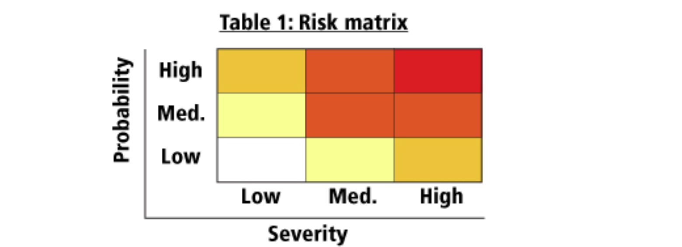
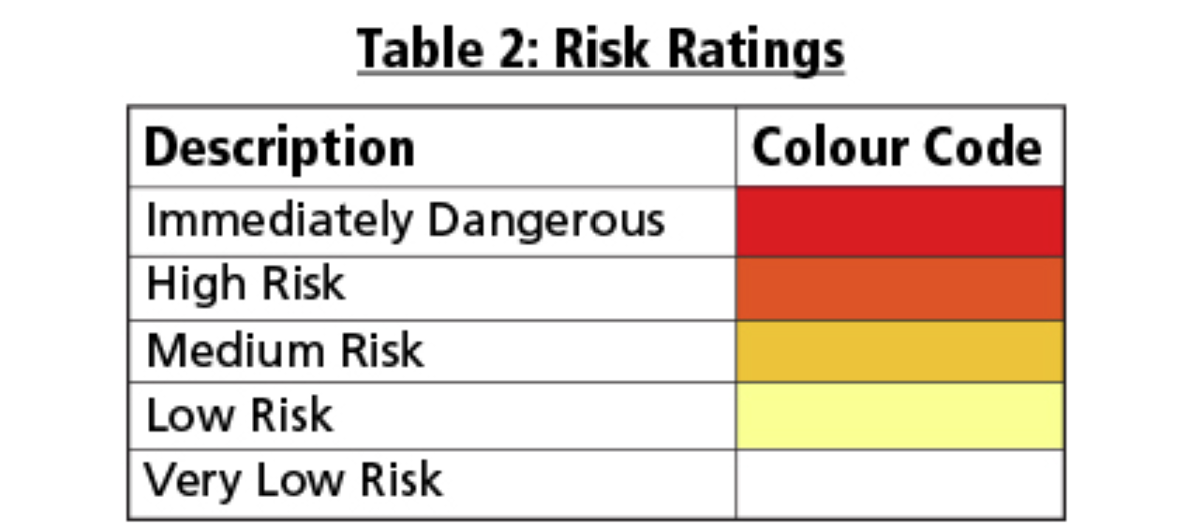
Determining Risk level
[1]
[1]
Risk Level = Impact/Severity x Probability/Likelihood [3]
Based on the above formulae, we determine the risk level for each risk mentioned in the previous slides:
Impact/Severity of risk is determined by the criticality of project and priority of attention required by the organization or OSS team to look into the issue.
Likelihood/Probability of risk is determined based on the control measures that are in place and the frequency of non-compliance that a project or any organization has which will determine the potential of encountering the risk [2].
[1]:Risk Assessment. (2017, February 15). Retrieved from www.ccohs.ca: https://www.ccohs.ca/oshanswers/hsprograms/risk_assessment.html
[2]: Chapter 4. Step Two: Determining Likelihood of Occurrence. (n.d.). Retrieved from compliancecosmos.org: https://compliancecosmos.org/chapter-4-step-two-determining-likelihood-occurrence
[3]: Risk Rating: Probability x Impact = Simplistic & Dangerous. (n.d.). Retrieved from riskinsights.com: https://riskinsights.com/risk-rating-probability-x-impact-simplistic-dangerous/
Notes:
Simple Slide

Slide 50
Change Management
Notes:
Title Slide

Slide 51
Acknowledging and Understanding why change is required[1]
Hadoop(Hive) requires 40 hours to process 330 queries on 100 TB of database. Also using Hadoop it is difficult to apply ML algorithms to achieve customer segmentation analysis.
Apache Spark seems to be the perfect solution to the above problems.
2. Communicate and Involve [2]
Integrate Apache Spark in Hadoop environment by March 2023 so that customer segmentation results are available by end of Q2.
Stakeholders : Data Analyst, Data Engineer, Data Architect, Marketing Manager, Software Engineer/Tester, Product Manager
GOAL: The analysis should take half the time or less than on Hadoop;
Data analysts should understand machine learning algorithms and Spark; Spark should process data faster than Hadoop.
SUCCESS METRICS: Newly added feature set to the product should increase revenues of the product line by at least 15%; The new research should generate at least 30% more leads than before; The performance for using Spark should be 3 times faster than Hadoop dataframe
3. Develop Change Plans[3]
Design Spark Architecture; Integrate Spark with YARN; Black Box Testing for integration of spark with YARN
Integrate Spark on existing HDFS layer; Data Access to Analyst; Functional test to check data access layer
Launch Spark on HDFS
Library upgrades for analyst to Identify key customer segments ; Alpha and Beta testing to validate query runtime
Data Visualization feature for implementing business strategies
4. Implement Change Plans
5. Evaluate Progress[1]
Compatibility with existing Hadoop System
Testing deployment (Early Access); Successful Training
Stakeholder’s approval; Dependencies Check (Ecosystem)
Data Privacy Check; Data consistency (ZERO data loss)
The ability to install/run Apache Spark successfully and perform customer segmentation;
Speed enhancement achieved (Test with number of queries)
[1] The Four Principles of Change Management. (n.d.). Retrieved from mindtools.com: https://www.mindtools.com/pages/article/newPPM_87.htm
[2] NCVO. (n.d.). FIVE STEPS TO SUCCESSFUL CHANGE. Retrieved from knowhow.ncvo.org.uk: https://knowhow.ncvo.org.uk/your-team/people-management-skills/change/basics-on-managing-change/fivesteps/five-steps-to-successful-change-1#
[3] Carracher, A. (n.d.). 6 components of Change Management to set you up for success. Retrieved from r10.global: https://www.r10.global/blog/6-components-of-change-management-to-set-you-up-for-success
Notes:
Average Slide

Slide 52
Stakeholders in Change Management
DATA ARCHITECT
DATA ANALYST
PRODUCT MANAGER
MARKETING MANAGER
SOFTWARE TESTER
Data architect, should be able to set Hadoop variables and configure memory allocation so that Spark can be integrated into current system architecture.
DA should provide limited access to data analysts so that they do not modify data stored in HDFS.
DA should be able to access the customer data using the modules / libraries provided by the Data Architect
DA should take half the time or less than on Hadoop.
DA should be able to provide the key customer segments in the visuals.
PM should be able to develop products that would resonate with specific target audience
Address pain points of customer segments
PM wants to use dashboards to visualize reports
Marketing Manager should be able to visualise the sales metrics
Should be able to generate at least 30% more leads
Thus generating 20% more overall revenue or customer acquisition
Tester should be able to ensure that module/library released by the data architect has no major bugs
Ensure that Spark module released by DAto data analyst has a faster performance of response time queries
Ensure that there are daily runs for UAT & functionalities are as expected
Notes:
Simple Slide
Reference :This slide is articulated based on specifics for our project

Slide 53
Project Planning
Notes:
Title Slide

Slide 54
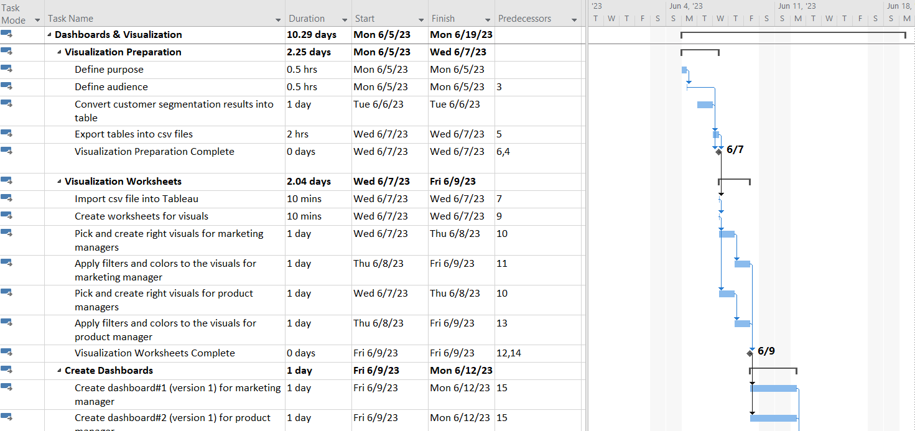
Project Plan Part 1
Notes:
Simple Slide

Slide 55
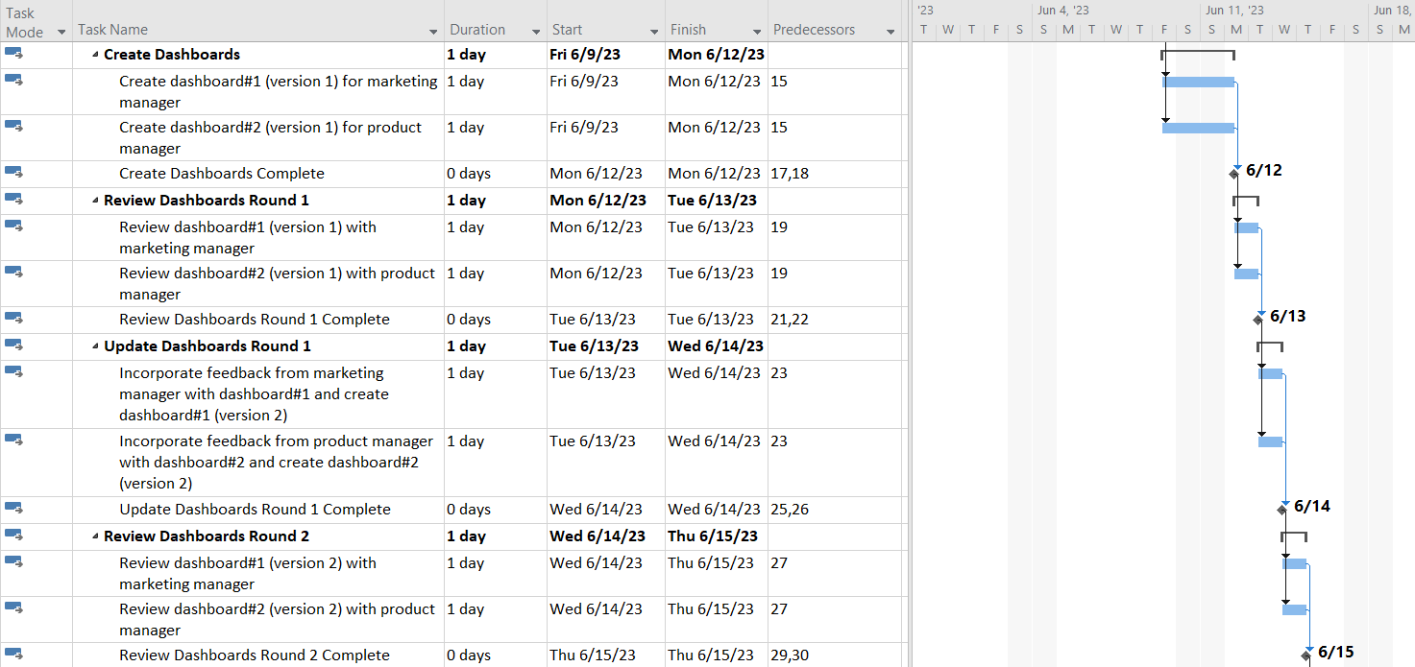
Project Plan Part 2
Notes:
Simple Slide

Slide 56
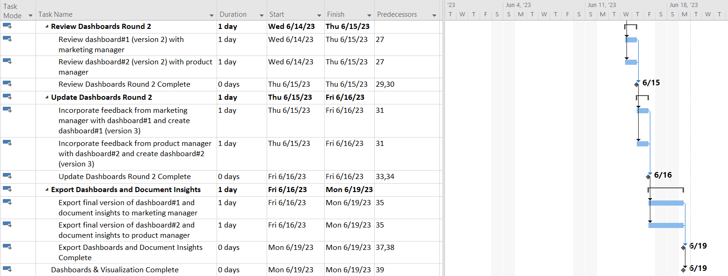
Project Plan Part 3
Notes:
Simple Slide

Slide 57
Apache Spark - Software Disaster
Low Level Design:
Spark RDD APIs – RDD stands for Resilient Distributed Datasets.It is an immutable distributed collection of elements of data, partitioned across nodes in clusters.[1]
We will be storing data in HDFS in RDD form. RDDs would be used by data analysts to perform customer segmentation analysis.
RDD’s are Resilient, i.e. fault-tolerant with the help of RDD lineage graph[2]
RDD’s are able to recompute missing or damaged partitions due to node failures.[2]
Spark Streaming is a stream processor built on top of Spark. It implements an abstraction called discretized streams (D-Streams), which takes advantage of RDDs and their lineage properties to divide potentially infinite streams of data into finite chunks and provide an interface to perform computation over it. The abstraction allows a micro-batch approach to streaming data, yielding high throughput, scalability and fault-tolerance[3]..
Assuming that all of the RDD transformations are deterministic, the data in the final transformed RDD will always be the same irrespective of failures in the Spark cluster[3].
This results in two types of data that needs to recover in the event of failure:
Data received and replicated – In this, the data gets replicated on one of the other nodes thus the data can be retrieved when a failure[4].
Data received but buffered for replication – The data is not replicated thus the only way to recover fault is by retrieving it again from the source[4].
[1] Resilient Distributed Dataset (RDD). (2022). Retrieved from databricks.com: https://databricks.com/glossary/what-is-rdd
[2] Arora, S. (2018, August 26). RDD: Spark’s Fault Tolerant In-Memory weapon. Retrieved from medium.com: https://medium.com/knoldus/rdd-sparks-fault-tolerant-in-memory-weapon-130f8df2f996
[3] Joao Carreira, J. L. (n.d.). Optimizing Latency and Throughput Trade-offs in a stream processing system. [4] Fault tolerance in Apache Spark – Reliable Spark Streaming. (n.d.). Retrieved from data-flair.training: https://data-flair.training/blogs/fault-tolerance-in-apache-spark/
Notes:
Simple Slide

Slide 58
Testing
Notes:
Title Slide

Slide 59
Testing plan overview
Testing Type | Unit Testing | Functional Testing | Integration & Installation Testing | Performance & Security Testing | Alpha Testing | Beta Testing
Persona | Data Architect | Software Tester | Data Architect & Software tester | Software Tester | Data Analyst | Product & Marketing Manager
Test goals | To ensure that the code within SPARK architecture is working properly without any bugs as well as the component & features like spark drivers, executors, cluster managers & working nodes are working well | To ensure that the SPARK architecture as a whole works well with no bugs or errors | To ensure there is smooth integration of YARN and SPARK and SPARK architecture is able to install/run successfully on HDFS layer | To ensure that Data analyst can access the library/module released by data architect with read-only access and performance level is 3 times faster | To ensure there are no issues when data analyst is accessing the data and that data analyst is able to identify key customer segments without any issues | To ensure that data analysts are able to build dashboards and visualizations efficiently
How this test will help in project | Helps to fix any bugs related to SPARK components early | Helps to fix any bugs related to SPARK architecture as a whole | Helps to ensure safe compatibility between SPARK module and HDFS layer | Helps to increase the performance level of the application and also to ensure that data privacy is not compromised | Helps to ensure that the overall business objective goal is met which is to increase productivity of data analyst | Helps to provide business insights to get more leads which will translate to sales efficiently at faster rate
Increment 1 | ✓ | ✓ | ✓
Increment 2 | ✓ | ✓ | ✓ | ✓ | ✓ | ✓
Increment 3 | ✓ | ✓ | ✓ |  | ✓ | ✓
Notes:
Simple Slide
Reference :This slide is articulated based on specifics for our project

Slide 60
Bug Tracking & Management - Release 1
OSS project will use Fuzz testing to track bugs and ensure system is robust and secure
Fuzz Testing:
A software testing technique of putting invalid or random data called FUZZ into software system to discover coding errors and security loopholes when integrating SPARK with HDFS layer[1]
Purpose of fuzz testing is inserting data using automated or semi-automated techniques and testing the system for various exceptions like Apache Spark crashing or failure of built-in code within the Spark architecture dataframes, etc[1]
Need for Fuzz Testing:
Often Spark programs run for days and then crash without an obvious reason[2].
Testing with sample data is often incomplete which leads to rare buggy cases in production runs[2].
Using fuzz testing we are able to monitor system behaviour and log defects[2]
Once bugs are resolved, status to be updated in error logs
Graphical reports to be created to view current state of the bugs:
Will classify bugs based on severity, status, component etc
[1]: Hamilton, T. (2022, April 30). Fuzz Testing(Fuzzing) Tutorial: What is, Types, Tools & Example. Retrieved from guru99.com: https://www.guru99.com/fuzz-testing.html
[2]: Zhang, Q., Wang, J., Kim, M., Padhye, R., & Gulzar, M. A. (n.d.). BigFuzz: Efficient Fuzz Testing for Data Analytics Using Framework Abstraction. Retrieved from ieeexplore.ieee.org: https://ieeexplore.ieee.org/document/9286115
Notes:
Simple Slide

Slide 61
THANKS
Team Sprinters
Members: Bhupinder Jagwani, Moranda Gao, Niveditha Shanbhag, Pallavi Saboo, Pratik Deshmukh, Zhaoyi Zhang,
Madhavi Ranganadha
Notes:
Title Slide

Slide 62
Burnup Chart
Notes:
Backup Slide

Slide 63
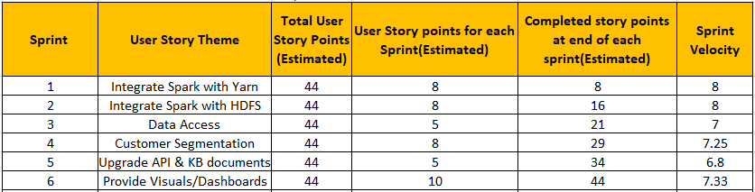
Estimated Burnup Chart
Total User Story Points(Estimated) - Sum of all the user story points
User Story Points for each sprint(Estimated)- User story points planned to be completed in each sprint
Completed story points at end of each sprint(Estimated)- Cumulative of completed story points at end of each sprint
Sprint Velocity - Completed Story Points at end of sprint(Estimated)/No of sprints completed
[1] YouTube. (2015). Create a Basic Burnup Chart. Retrieved May 30, 2022, from https://www.youtube.com/watch?v=N07I0mdR7WQ&t=176s.
Notes:
Backup Slide

Slide 64
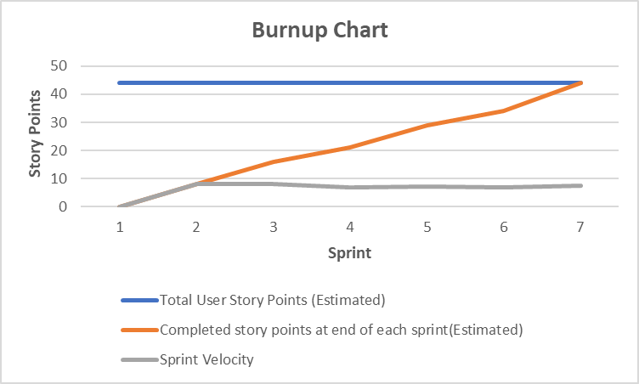
Estimated Burnup Chart
Notes:
Backup Slide

Slide 65
Burndown Chart
Notes:
Backup Slide

Slide 66
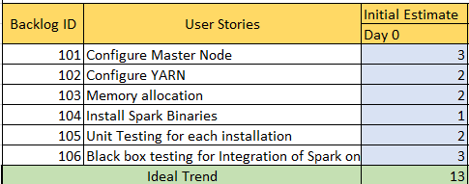
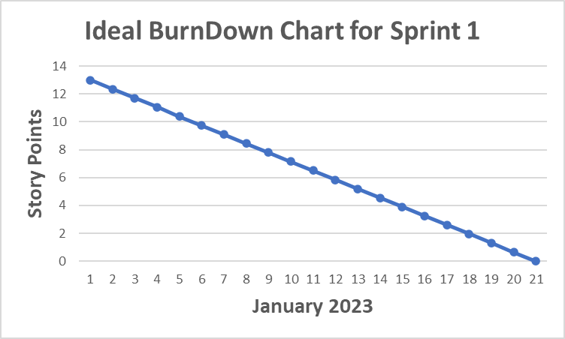
Sprint 1: Ideal Burndown Chart
Challenges that can skew the Ideal trend :
Incorrect memory allocation for clusters can cause delay in completion of task.
Debugging the code can take up extra time than anticipated.
Incorrect configuration on YARN can cause delays.
Incorrect estimation of effort can cause scope creep.
[1] Houbart, F. (2021, August 20). Running Spark on Top of a Hadoop YARN Cluster. Retrieved from linode.com: https://www.linode.com/docs/guides/install-configure-run-spark-on-top-of-hadoop-yarn-cluster/
Notes:
Backup Slide

